Slide 1
Suicide and the world
Presentation #1 Columbia Data Analytics Bootcamp, September 2019

Slide 2



The team
Hayden Esman
James Pelham
Viktoriya Smith

Slide 3
Why suicide?
“Close to 800 000 people die due to suicide every year, which is one person every 40 seconds. Suicide is a global phenomenon and occurs throughout the lifespan. Effective and evidence-based interventions can be implemented at population, sub-population and individual levels to prevent suicide and suicide attempts. There are indications that for each adult who died by suicide there may have been more than 20 others attempting suicide. “*
*World Health Organization (https://www.who.int/mental_health/prevention/suicide/suicideprevent/en/)

Slide 4
Areas of focus
Global Suicide data
- gender and population
- suicide and freedom
- latitude and temperature
Suicide rate by US states
Obesity and suicide
Suicide and mental hospitals

Slide 5



Global Suicide data

Slide 6
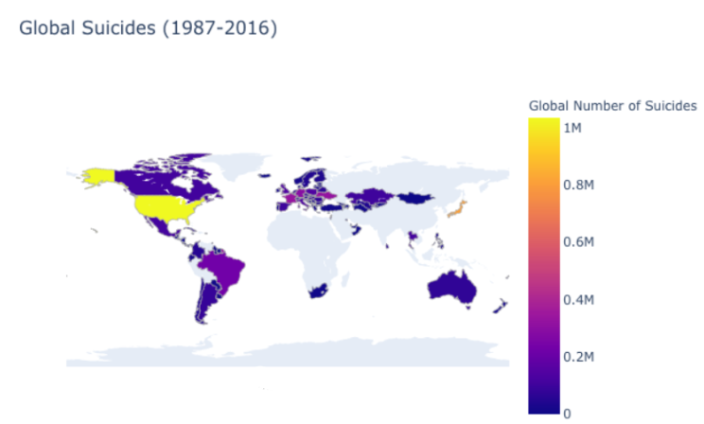
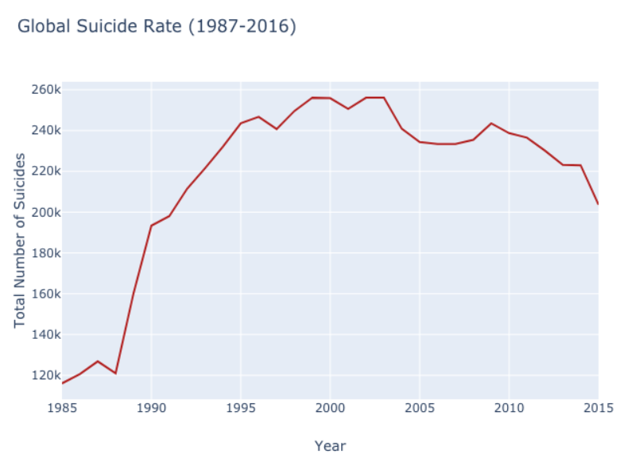

Slide 7
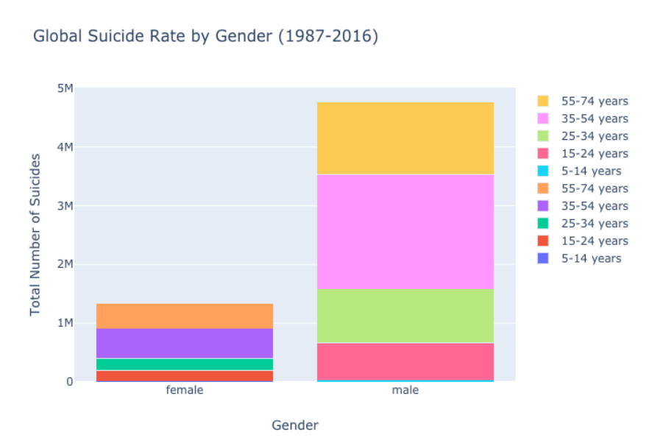
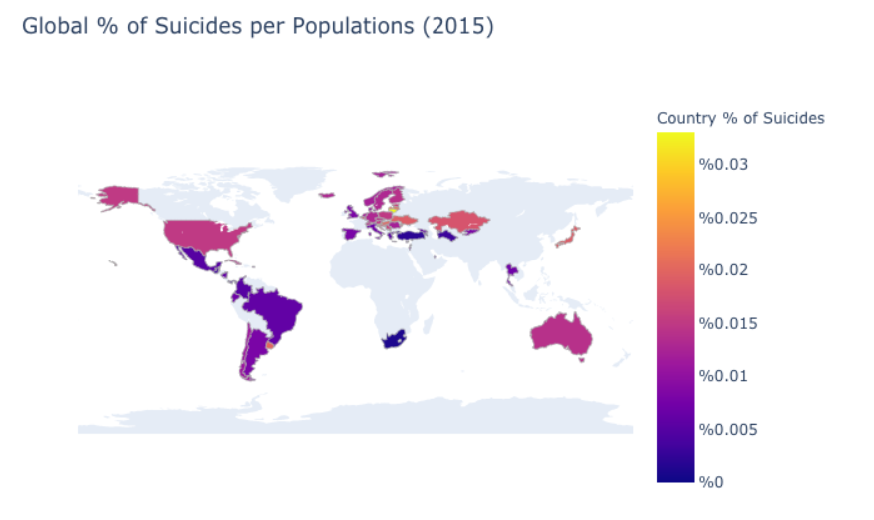
Gender and population

Slide 8
Outside factors

Slide 9
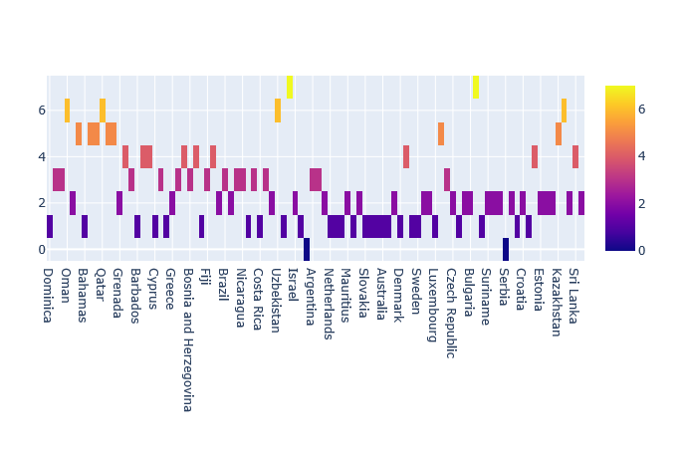
Suicide and freedom
Measure of Political Liberty
Least Oppressed
Most Oppressed

Slide 10
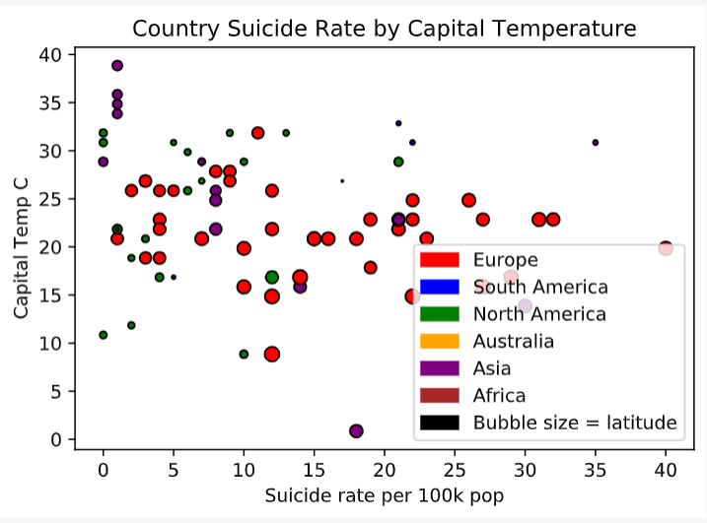
temperature

Slide 11
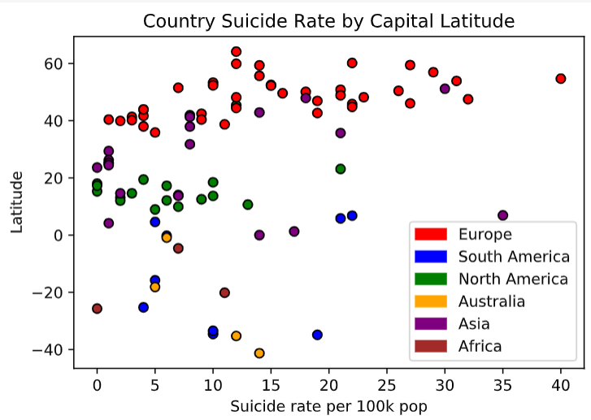
Latitude

Slide 12
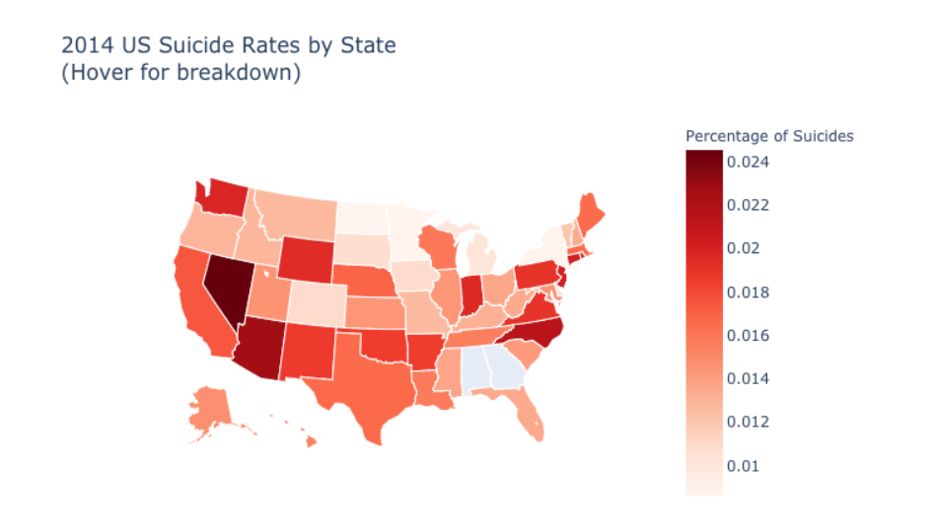
2014 US suicide rate (per state)

Slide 13
Obesity and suicide

Slide 14
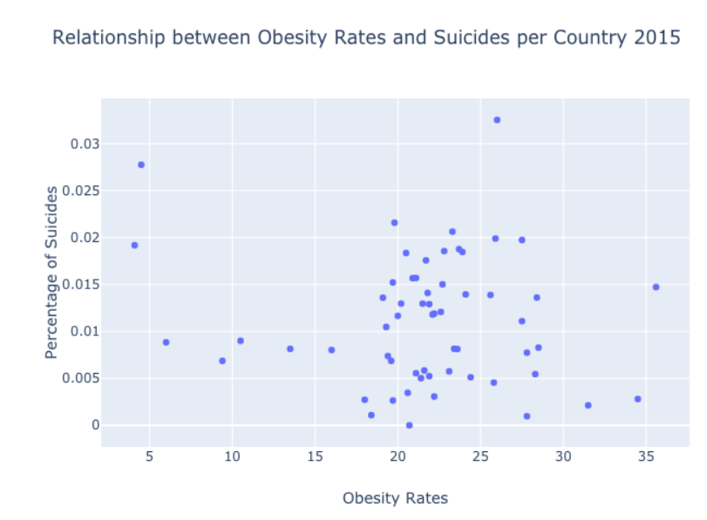
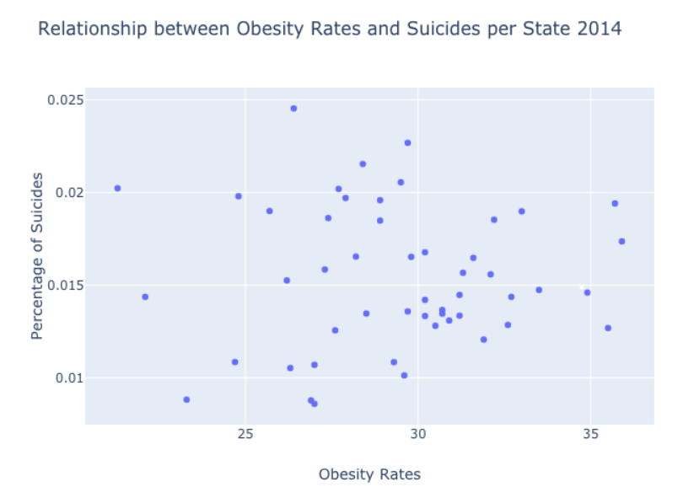
Global and national

Slide 15

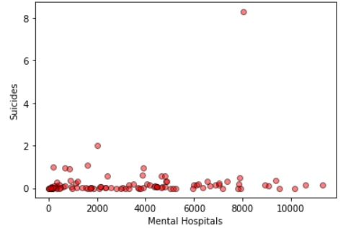
Suicide and mental hospitals
Japan

Slide 16
Q&A

